Slide 1
Cryptography
Sides for Security in Computing 4th Ed.
Chapter 7.1-7.2
CPTR 427 - Scot Anderson, Ph.D.

Slide 2
Outline
Networks vs. Stand-alone environments
Network Topology review
Threats
  Authentication/Authorization
  Confidentiality
  Integrity
  Availability

Slide 3
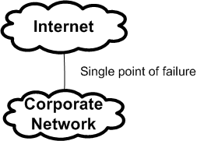
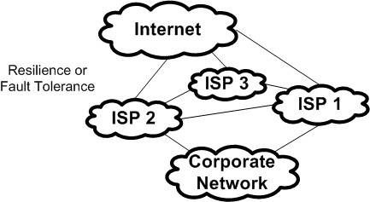
Network Environments
Single Point of failure
Fault tolerance or resilience
High Reliability by design!
Networks are often less resilient at endpoints than in the middle (strong vs. fragile)
Networks are much more complex than they appear

Slide 4
Terminology
Node: Router, Host or other networked hardware
Host: Server, Workstation or other End user device
Server: Host that provides services
Workstation: Host that consumes services
Link: Communication channel between two notes
Network Topology: the way nodes and links are configured in a network (think shape)

Slide 5
Networks are described as…
Anonymous
Automated
Spanning great Physical distance transparently
Opaque – You can’t tell just by looking where the system you are connected to resides.
Route Diversity – How your data travels is diverse and changing

Slide 6
Network Concerns
Network Boundary
Ownership (connection to my network doesn’t necessarily mean I own it)
Control

Slide 7
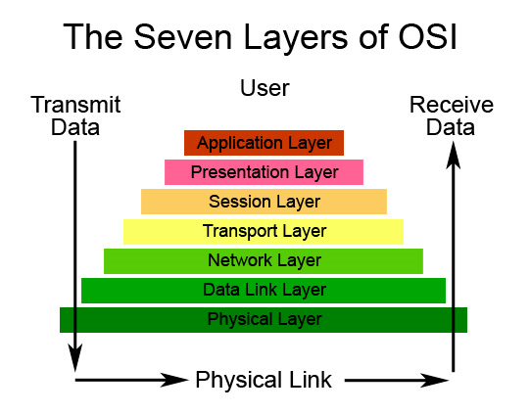
Network Protocols
Can you identify the most common protocols used at each layer?

Slide 8
Why is Layering so important?
Allows a complex process to be broken up into logical units that can be implemented independently
Allows a separation of duty
Changes in one layer may be implemented independent of other layers
Allows the encapsulation of functionality
Important in security considerations…

Slide 9
Network topics NOT covered
Addressing
Routing concepts
Types of networks (LANs, WANs, etc)
YOU SHOULD ALREADY KNOW THIS STUFF!

Slide 10
Threats in Networks
Threats aim to compromise:
  Confidentiality
  Integrity
  Availability
… and may be applied against
  Data
  Software or
  Hardware
Attacks could be accidents, non-malicious or malicious

Slide 11
Networks vs. Single Machine
Anonymity
Many targets
Resources being shared (e.g. an attack surface exists)
Networks are complex (often not configured correctly)
Network boundary uncertain (think wireless)
Unknown path

Slide 12
The Psychology of the Attacker
Motivated by:
  Challenge
  Fame
  Money/Espionage
  Organized Crime
  Ideology

Slide 13
Reconnaissance (HE 1-4)
Port Scans
Social Engineering
Intelligence gathering (foot-printing)
The best defense is silence

Slide 14
Direct Threats
Eavesdropping and Wire Tapping
  Active
  Passive (inductance tapping)
  Wireless is easiest
  Fiber is hardest (any cut can be detected)
Protocol Flaws (WEP)

Slide 15
Authentication Threats
Guessing (brute force)
Avoidance (circumvent authentication)
Masquerade
Session Hijacking

Slide 16
Confidentiality Threats
Miss-delivery (we’ve seen MAC spoofing)
Exposure (through unsafe buffers etc.)
Traffic flow analysis

Slide 17
Integrity Threats
Change Content
Replace message
Reuse/replay message
Combine different messages
Redirect message
Destroy message

Slide 18
Protocol Format Failures
Breaking protocol rules to hack a service
Examples:
2003 RPC patch from Microsoft
SNMP https://www.kb.cert.org/vuls/id/107186

Slide 19
Web-site Threats
Website defacement
  See www.zone-h.org (see OnHold section)
Buffer overflows again…
Available executables ../../../…
Server-side includes:
<!-#exec cmd=“/usr/bin/telnet &”->

Slide 20
DoS
ICMP
  Ping
  Echo
  Destination unreachable
  Source quence
Echo-Chargen: Network testing utility can talk to itself…
Ping –f (flood ping)
Smurf – send a ping request in broadcast mode spoofing as the source address of the target of the attack.
Syn Flood
Teardrop – fragmenting packets in overlapping ways may cause DoS.
DNS DoS. Redirecting traffic…

Slide 21
DDoS Attacks
DDoS is a coordinated effort to overwhelm a host – usually accomplished with a bot army.
http://www.securitywizardry.com/radar.htm
  Click the ARBOR networks Attack sources to look at DDoS
“Our company has been the recipient of 14 DOS/Extortion attempts over the last 9 months. These aren't script kiddies.. The trails lead to Russia.” – 2005
Theft of IP (Google news)concerns continue in the wake of the google IP thefts by Chinese BotNets

Slide 22
Summary
Reconnaissance: precursors to an attack
Authentication/Authorization Attacks
Confidentiality Attacks
Integrity Attacks
Availability Attacks
Program Flaw exploits

