Slide 1
Cryptography
Sides for Security in Computing 4th Ed.
Chapter 7.1-7.2
CPTR 427 - Scot Anderson, Ph.D.

Slide 2
Outline
Network Security Controls
Firewalls
Intrusion Detection Systems (IDS)
Email Security

Slide 3
Implementing Network Security Controls (NSC)
What are the threats? (Threat Analysis)
Architectures of a NSC systems
Encryption (again) controls
Integrity controls
Authentication Controls
Access (Authorization) controls (firewalls only)

Slide 4
Threat Analysis examines…
Intercepting data in traffic
Accessing programs or data at remote hosts
Modifying programs or data at remote hosts
Modifying data in transit
Inserting communications
Impersonating a user
Replaying a previous communication
Blocking selected/all traffic
Running a program at a remote host.

Slide 5
Architect a Strategy (PLAN)
How can I say it stronger? The most important thing to do before you go implementing your security controls is to…
PLAN

Slide 6
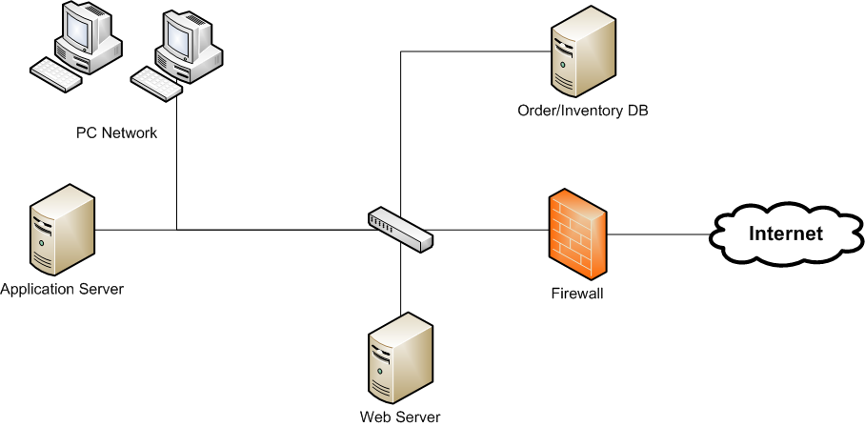
Architect: Segmentation
One machine → Many Machines
One server → Many Servers

Slide 7
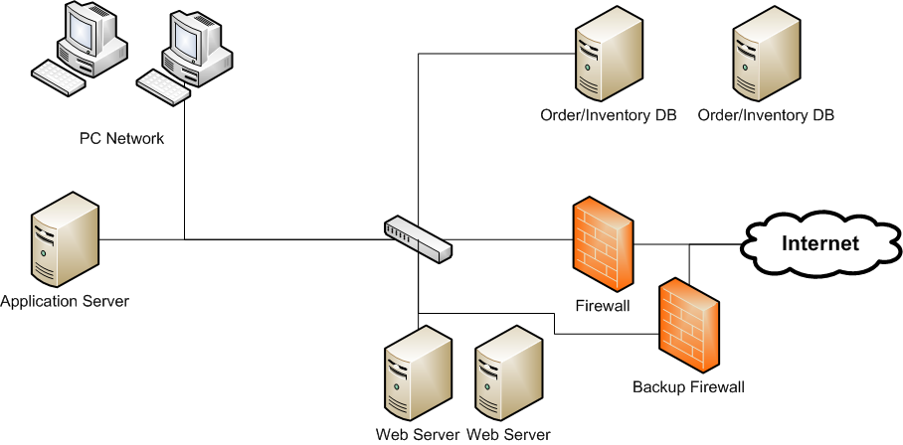
Architect: Redundancy/SPOF
Notes:
Single Point of Failure

Slide 8
Encrypting Traffic Ctrl
Link Encryption
  Layer 1 or 2
  Transparent to the end user
  Easy, but a key distribution nightmare
  Example WEP/WPA
End-to-End Encryption
  Host-to-Host at Layer 7 (or 6)
  Secure even in intermediate hosts
  Still has Key dist. Problem
  Example: VPN/IPSec

Slide 9

VPN Basics Ctrl
E.g. End-to-end Data protection using SSL as a tunnel

Slide 10
PKI and Certificates Ex.
DEMO: Look at an actual SSL Certificate - Identify
  Certificate Authorities
  Expiration
  Hierarchical Chain of authority
  Revocation?
It all starts with…
TRUST

Slide 11
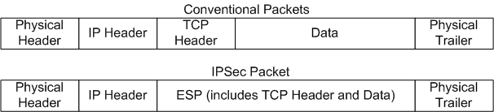
IPSec Ex.(page 454-455)
We could do an entire class period on this!
Security Association?
Security Parameter Index (SPI)?
Encapsulated Security Payload (ESP)?
ISAKMP and IKE?

Slide 12
Cryptographic Hash Ex.
You are familiar with Hash codes (e.g. MD5, SHA)
A cryptographic Hash also called a message digest or Cryptographic checksum
Hash depends on password or phrase. E.g. pre-pending a phrase before running the MD5 or SHA algorithm on the plaintext. Or using a cipher algorithm with block chaining such as AES.
Ex: Message Integrity
Ex: Code signing

Slide 13
Authentication
Single Sign On and LDAP
Kerberos (461)
Contrary to the book, Kerberos is in wide use!
INSERT GRAPHIC OF KERBEROS HERE! XXX

Slide 14
Other Controls
Alarms and Alerts (IDS)
Honey Pots
Traffic Flow Security

Slide 15

Firewalls
Packet Filtering gateways and screening routers
Stateful Packet Inspection Firewall
Application Proxy / Guard
Personal Firewalls
Bridging Firewalls
PRIMARY PERIMETER
DEFENSE! Not for internal
Use.
Example

Slide 16
Intrusion Detection Systems
Network-based IDS
  One Listen only interface on network to be sniffed
  One control interface on private network both I/O
Host-based IDS
Types:
  Signature Based
  Heuristic

Slide 17
Email Security
User Level/Active Email Security Mechanisms
  PGP
  GnuPG
System Level Email Security: S/MIME
  X.509 Certificates
  Uses DES, AES and RC2
May be used to authenticate mail or encrypt mail or both.

