Slide 1
Non-Technical Security Controls

Slide 2
Outline
Security Planning
Risk Analysis
Policy
Physical Control (beyond the scope of this class)

Slide 3
Security Planning
Every organization using computers to create and store valuable assets should perform thorough and effective security planning.
A security plan is: “A document that describes how an organization will address its security needs.” p 509

Slide 4
Security Plan Addresses…
Policy
Current State
Requirements
Recommended Controls
Accountability
Timetable (implementation milestones)
Continuing attention (procedure for updating the security plan)

Slide 5
Security Plan: Policy
Answers:
  Who should be allowed access
  To what resources should access be allowed
  What type of access should each user be allowed for each resource.
By Specifying:
  Organization’s goals on security
  Where responsibility for security lies
  The organization’s level of commitment.

Slide 6
Security Plan: Current Security Status
Determine by performing a risk analysis (later)
Detail process for dealing with newly identified vulnerabilities
Identify current responsible individuals
Identify limits of responsibility

Slide 7
Security Plan: Requirements
Heart of the security plan!
Functional or performance demands placed on the system to ensure the desired level of security
Leaves the implementation details out…

Slide 8
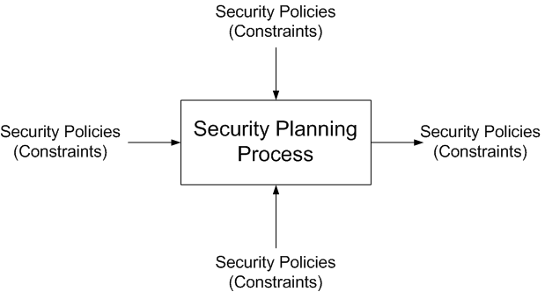
Security Plan: Interaction

Slide 9
Requirements Characteristics
Correctness
Consistency
Completeness
Realism
Need
Verifiability
Traceability

Slide 10
Security Plan: The rest…
Recommended Controls
Responsibility for Implementation
Timetable
Continuing Attention

Slide 11
Security Planning Team Members
Hardware group
Sysadmins
System programmers
Application programmers
Data entry personnel
Physical security personnel
Representative users

Slide 12
Assuring Commitment

Slide 13
Business Continuity Plans
Catastrophic situations
Long duration
In circumstances such as
  Fire
  Software or Hardware failures
  Utility failures
  Floods
  Civic/Terrorist disturbances

Slide 14
Continuity Plan
Assess Business Impact
Develop Strategy
Develop a plan from your Strategy
  Who is in charge (one person)
  What to do
  Who does it

Slide 15
Incident Plan
Different than continuity – security incident
  Define what constitutes an incident
  Who is responsible for taking charge
  Plan of action
Advance Planning
Response Team
  Director
  Lead Technician
  Advisors (Legal, HR, PR, staff etc).
After the incident…

Slide 16
Risk Analysis (8.2)
Risk defined in terms of
  Loss associate with event – Risk Impact
  Likelihood of event occurring (0,1):1→PROBLEM
  Degree to which we can change the outcome Risk Control
Strategies
  Avoiding
  Transferring
  Assuming

Slide 17
Quantifying Risk
Risk Exposure = Risk Impact  Risk Probability

Slide 18
Steps to Risk Analysis
Identify assets
Determine vulnerabilities
Estimate likelihood of exploitation
Compute expected annual loss
Survey applicable controls and their costs
Project annual savings of control

Slide 19
Step 1: Identify Assets
Hardware
Software
Data
People
Documentation
Supplies

Slide 20
Step 2: Determine Vulnerabilities
Imagination
Look at the three basics
  Confidentiality
  Integrity
  Availability
Notes:
No one list works

Slide 21
Vulnerabilities Enabling a Trojan Horse
Design/Architecture
Singularity
  Uniqueness
  Centrality
  Homogeneity
Separability
Logic/implementation
errors; fallibility
Design sensitivity,
fragility, limits,
finiteness
Unrecoverability
Behavioral
Behavioral sensitivity/
fragility
Malevolence
Rigidity
Malleability
Gullibility,
deceivability, naiveté
Complacency
Corruptibility,
controllability
General
Accessible,
detectable,
identifieable,
transparent,
interceptable
Hard to manage or control
Self-unawareness and unpredictability
Predictability
Trogan Horse

Slide 22
Step 3: Estimating Likelihood
Let the experts estimate using a table
Aggregate the experts votes
Let them all see the votes and change their votes if they want.
If they all agree you’re done.
There are other ways.

Slide 23
Step 4: Computing Expected Loss
Extremely subjective, but includes:
Legal obligations to confidentiality/integrity
Contractual Obligations
Could release cause harm?
Future business ramifications
PR problems/psychological effects
…(p 536)

Slide 24
Step 5: Survey/Select New Controls
 | Technique 1 | Technique 2 | Technique 3 | Technique 4
Vulnerability A
Vulnerability B
Vulnerability C
Vulnerability D
Vulnerability E
Vulnerability F |  | Primary
Vulnerability G |  | Secondary | Secondary | Primary
…
Vulnerability T |  |  | Caution
Notes:
The goal is to match all vulnerabilities with controls
Just remember controls can have negative effects.

Slide 25
Step 6: Project Savings
Table 8-7 Justification of Access Control Software
Item | Amount
Risks: disclosure of company confidential data, computation based on incorrect data
Cost to reconstruct correct data: $1,000,000 @ 10% likelihood per year | $100,000.00
Effectiveness of access control software: 60% | -$60,000.00
Cost of access control software | $25,000.00
Expected annual costs due to loss and controls | $65,000.00
Savings | $35,000.00

Slide 26
Risk Analysis: Yes/No
Positive reasons?
Negative reasons?

